Slide 1


SAP UI5 & FIORI with OData TRAINING using BAS
Anubhav Oberoy
Day – 10

Slide 2

Agenda – Day 10
Introduction to List controls in SAP UI5
Types of List in UI5
Creating model in Manifest.json
Search Functionality
List Modes and Grouping
Header and Footer Toolbar
Worklist Application

Slide 3
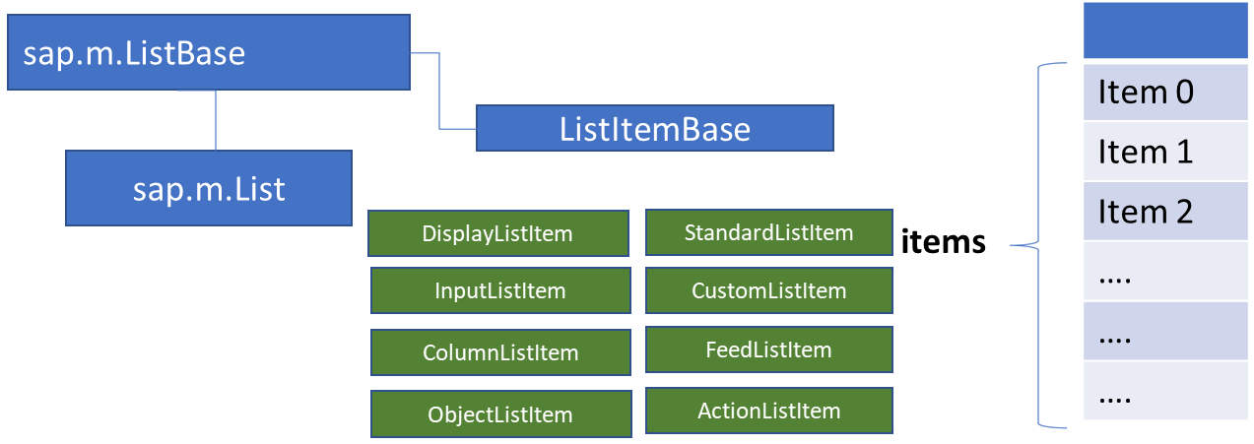
List Control
The list contains various list items. These items can be of various types depending on the use case and on the content they have. SAPUI5 already provides the most common list items in SAP Fiori in the form of controls, although custom list items can also be created if necessary.
Reference: https://sapui5.hana.ondemand.com/#/entity/sap.m.List
A List control is a single column table with multiple items inside. We will have a list header and items as aggregation.

Slide 4
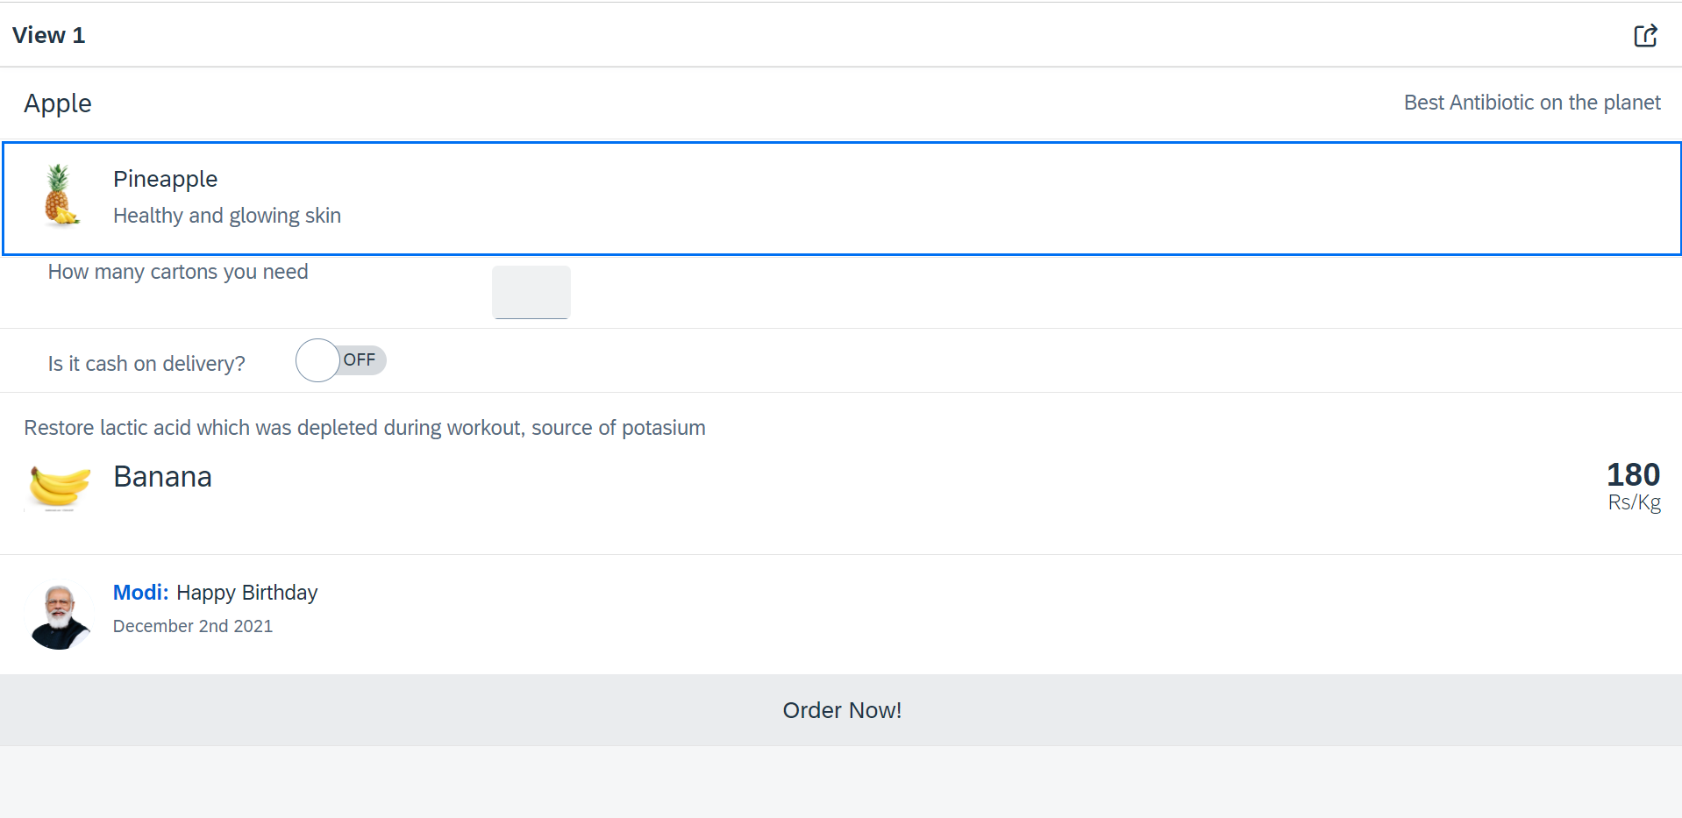
Hands – on: List Controls in UI5
Now we will add some basics list controls in the View1 of our application.
Code Links:
View1.view.xml

Slide 5
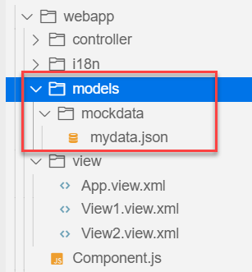
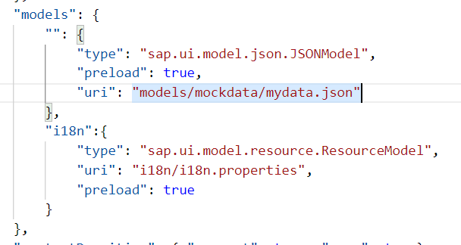
Hands – on: Models in manifest.json
Now we want to bind our list control to a model to show the multiple records using the list control.
For this first we need a file with some demo data related to the fruits, so we have created a file which has three entity sets:
fruits – name, color, type (neutral, citrus, alkaline),price, healthBenefit, unit, status (available, discontinued, out of stock), image (url from google) – 20
cities – name, state, famousFor, population – 10
supplier – name, city, country, contactPerson, phone, email, sinceWhen – 10
Now we will create a models folder in the webapp and in the models folder we will create a folder named mockdata, we will put our json file in this folder.
Code Link:
manifest.json
mydata.json
View1.view.xml

Slide 6
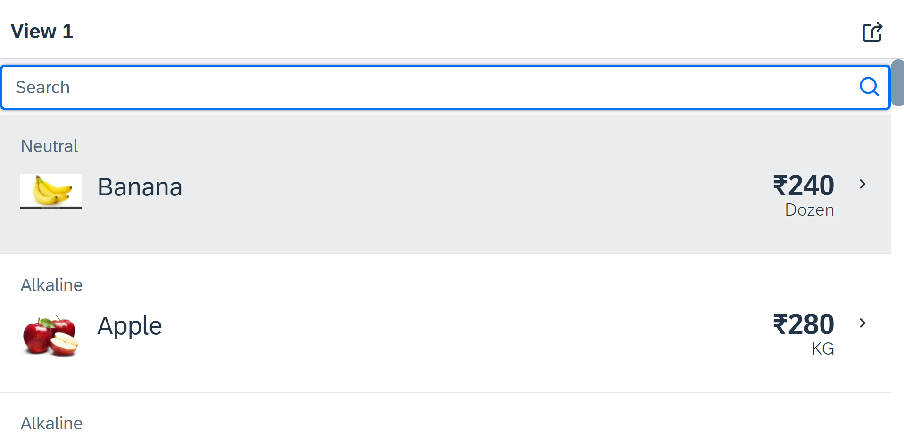
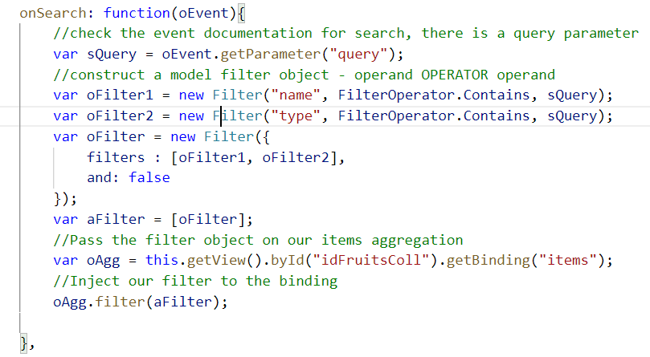
Hands – on: Search Functionality
Nowadays we come across many web pages that provide data in the form of lists or tables. These lists are enabled with search functionality, i.e., as the user types in into the search field and press enter then the data in the list is filtered according to the value in search field.
Code Link:
View1.view.xml
View1.controller.js

Slide 7
List Modes
The mode property defines the appearance of the left area of a list item.
Lists have properties and events and they contain list items that inherit from sap.m.ListItemBase, which provides navigation, selection and event features.
Delete
SingleSelect
01
04
only one list item can be deleted via provided delete button
Right-positioned single selection mode (only one list item can be selected).
01
04
MultiSelect
You can edit this text
SingleSelectLeft
02
05
02
more than one list item can be selected
05
Left-positioned single selection mode (only one list item can be selected).
03
06
None
03
06
SingleSelectMaster
no selection
Selected item is highlighted but no selection control is visible (only one list item can be selected).

Slide 8
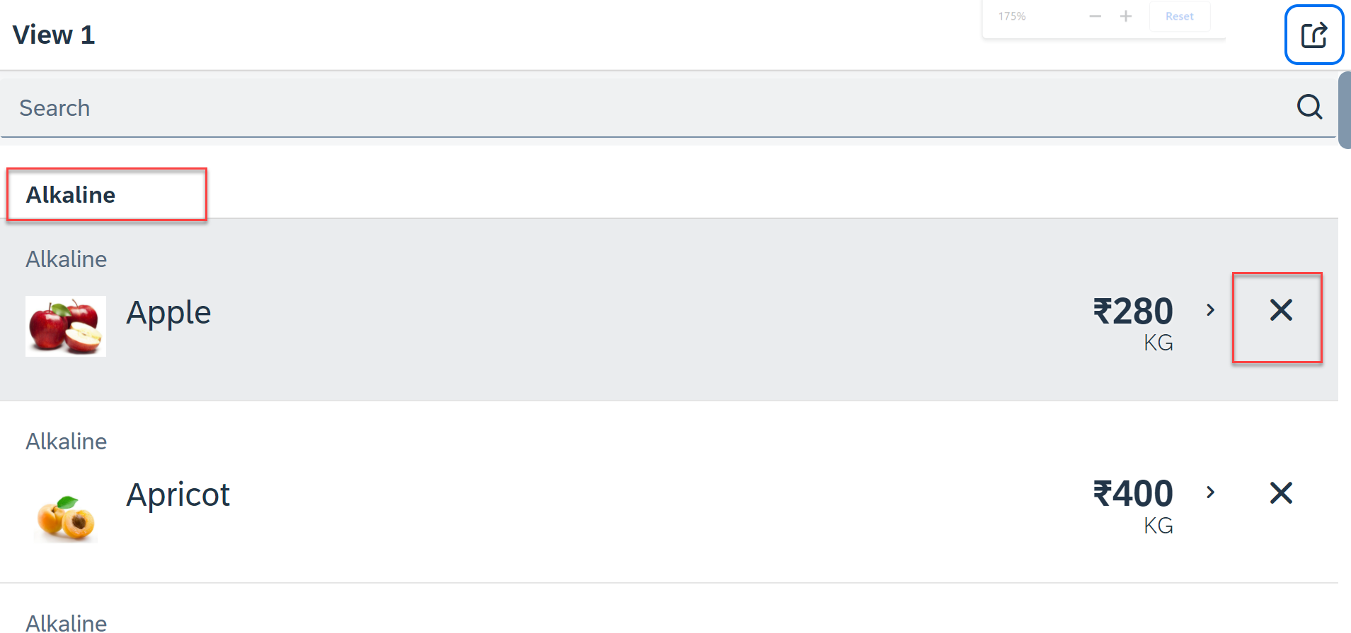
Hands – on: List modes and Grouping
Now we will look at the different type of List mode provided by the UI5.
Along with that we will Implement the Press event, Selection change and Delete Event in the List Control.
Also we will Group the data according to the type of Fruit.
Code Link:
View1.view.xml
View1.controller.js

Slide 9
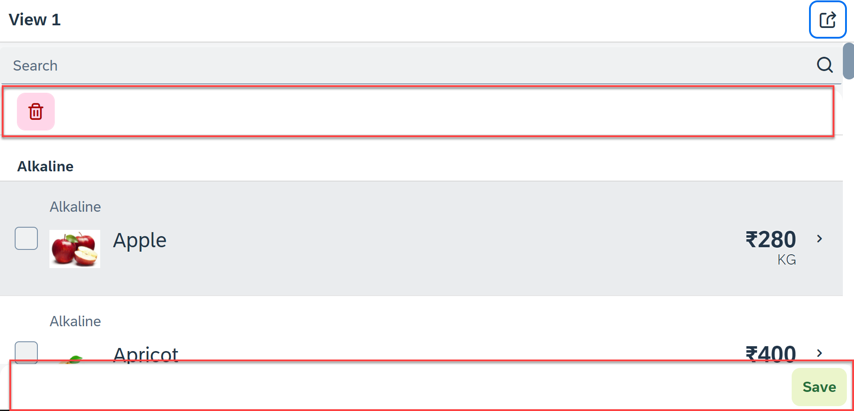
Hands – on: Header and Footer Toolbar
Now we will add a Header Toolbar to the list control and in that we will add a delete button to delete multiple items from the List.
We will also add a Footer toolbar to the page control and in that we will add a save button on press of the save button a alert will be shown to the user.
Code Link:
View1.view.xml
View1.controller.js

Slide 10
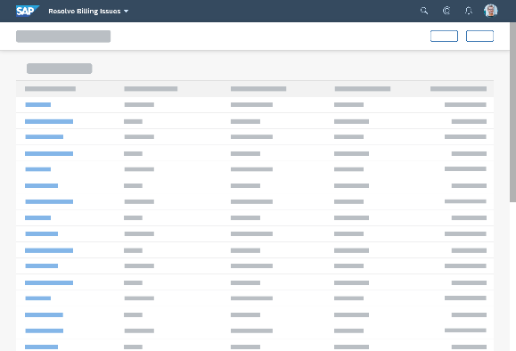
Introduction to Worklist Application
A worklist displays a collection of items a user needs to process. Working through the list usually involves reviewing details of the items and taking action. In most cases, the user has to either complete a work item or delegate it.
When to use:
Users have numerous work items and need to decide which ones to process first.
You want to give users a direct entry point for taking action on work items.
Users need to work with multiple views of the same content (for example, items that are “Open”, “In Process”, or “Completed”). You want to offer tabs for switching between views.
Detail View
List Page

Slide 11
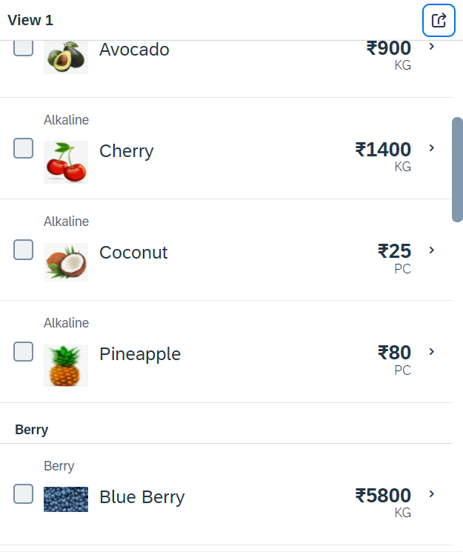
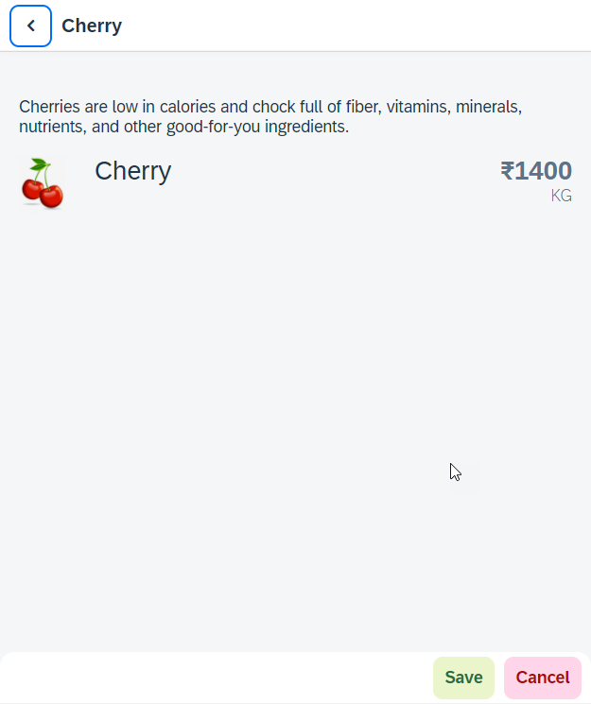
Hands – on: Worklist App
Now we will make our application a worklist app. On selecting the fruit on the View1 navigate to the View2 and show the details of that the selected fruit on it.
For this we have to modify the onSelectItem Function to get the path of the selected item and pass it in the onNext function.
Code Link:
View1.view.xml
View1.controller.js
View2.view.xml

Slide 12

End of Day 10

Slide 13

Questions

Slide 14

Anubhav Oberoy

Slide 15


We’re committed to empower you to be
Most Desirable Resource
through powerful training solutions.
We build the workforce of the future.
250+
Corporate Clients
30,000+
Learners Trained
25000+
Learners Placed
FREE WEBINARS
Sign up for free webinars with industry experts every fortnight!
Enroll Now!
Contact us today!
https://anubhavtrainings.com/

Slide 16




More from AnubhavTrainings.com

Slide 17
Title
Content

